Slide 1
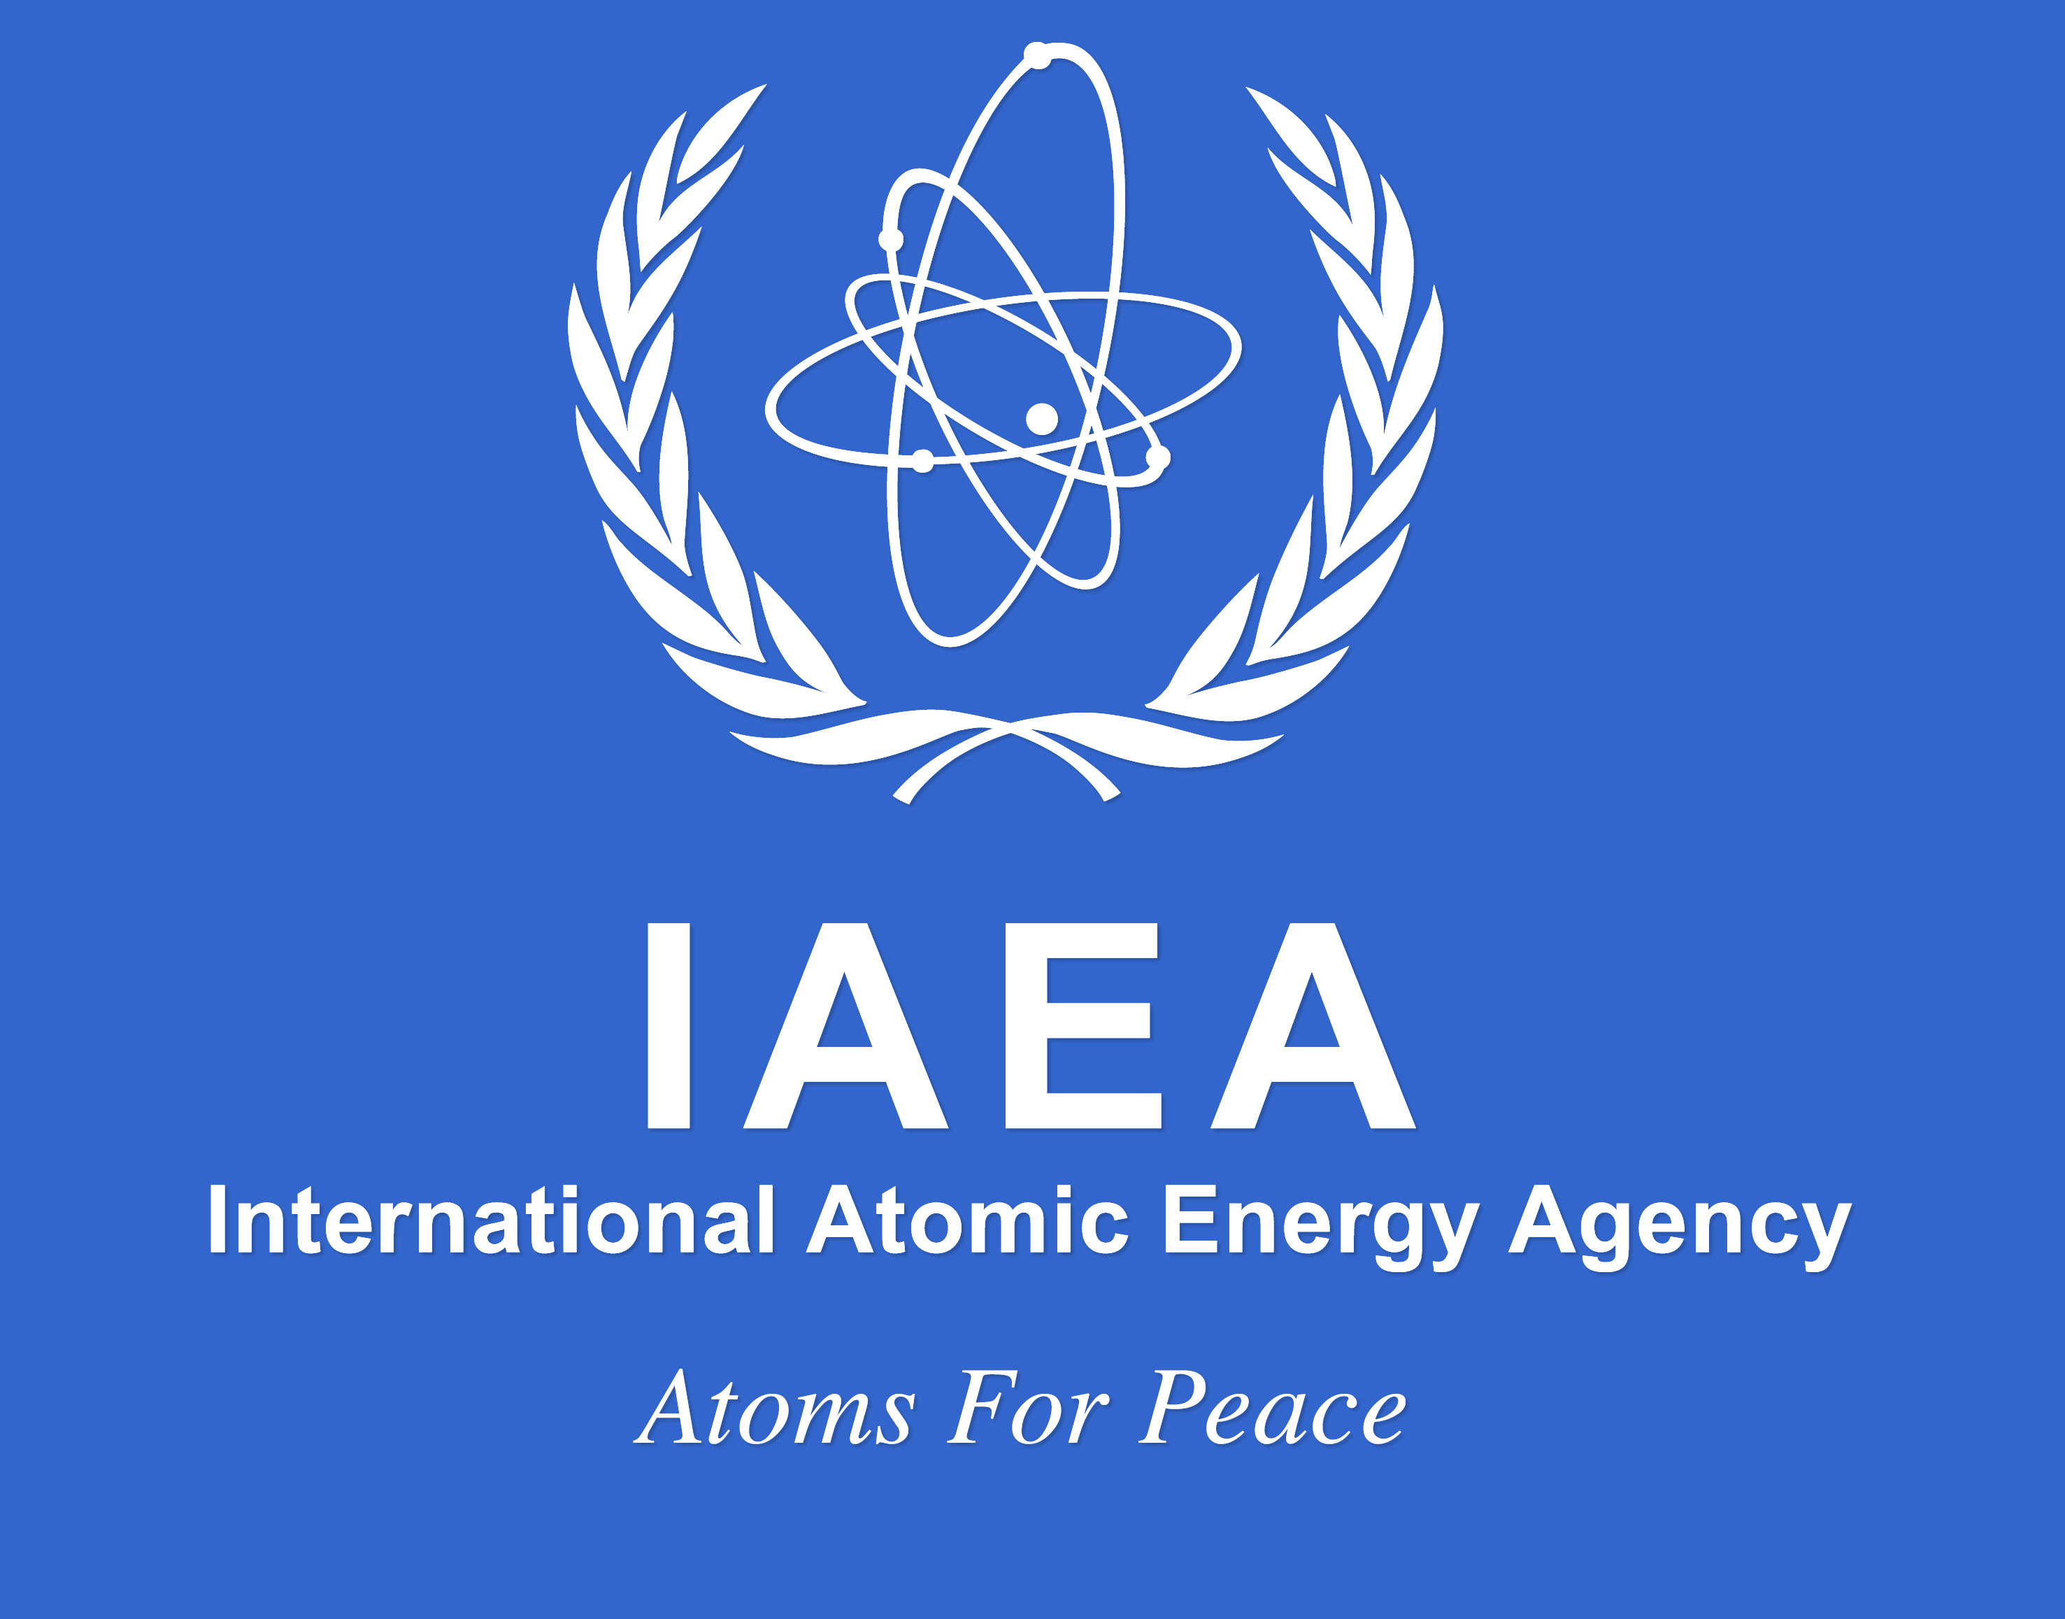

Slide 2

Goiâna Radiation Accident in Brazil
13 September 1987
On 13 September 1987, some local scavengers discovered an unusual object–although they did not know it, a caesium-137 radioactive source–in an abandoned private radiotherapy clinic, the Instituto Goiano de Radioterapia. It had been left unprotected as the daytime security guard had abandoned his post and taken his family to the cinema (where they reportedly watched Herbie Goes Bananas). In da Silva’s absence two scavengers robbed the dangerous device, which was like nothing they had ever seen before. Curious, they gouged out its iridium window and prised apart its protective lead and steel casing to access the tiny cylinder of caesium chloride at its heart, allowing both beautiful blue light–caused by either Cherenkov radiation or fluorescence–and dangerous high gamma radiation to escape. Both fell sick, and soon afterwards they sold the radioactive source to a junkyard owner.
Because of its bright blue glow the caesium chloride was thought of as an attractive, even magical, material, and it was used for a variety of decorative purposes. No one was aware of its radioactive harmfulness: some rubbed the glowing substance all over their skin, and one unlucky six-year-old girl even ingested some. So far over 200 individuals have been found to have caesium chloride contamination, 20 have been found to have suffered serious radiation and, despite thorough decontamination and radiation-damage treatment, four have already died. However, like so many radiation disasters–such as Chernobyl the previous year–it was all too preventable. In this case, the cause of the Goiânia Radiation Accident was an unforgivable failure by the Brazilian nuclear authorities to adequately account for, and inspect, all the radioactive sources in the country. At the end of the day, horrific damage was done by just 93 grams of caesium chloride in a container the size of a thimble

Slide 3
巴西戈亚尼亚核辐射事故 1987年9月13日
1987年9月13日，一些当地的拾荒者在一家废弃的私人放射治疗诊所，即放射性甲状腺研究所，发现了一个不寻常的物体——尽管他们并不知道，一个铯-137放射源。由于白天的保安放弃了他的岗位，带着他的家人去看电影（据报道，他们在电影里看到赫比发疯），电影没有受到保护。在达席尔瓦不在的时候，两个拾荒者抢劫了这个危险的装置，这是他们以前从未见过的。好奇的是，他们挖出了铱窗，撬开了它的铅和钢保护壳，进入了它心脏处的氯化铯小圆柱体，让美丽的蓝光（由切伦科夫辐射或荧光引起）和危险的高伽马辐射逃逸。两人都生病了，不久之后他们把放射源卖给了一个垃圾场老板。
由于其明亮的蓝色光芒，氯化铯被认为是一种有吸引力的，甚至是神奇的材料，它被用于各种装饰用途。没有人意识到它的放射性危害：一些人把发光物质擦得满身都是，一个不幸的6岁女孩甚至吞下了一些。迄今为止，已发现200多人受到氯化铯污染，20人受到严重辐射，尽管进行了彻底的净化和辐射损伤治疗，但已有4人死亡。然而，就像许多辐射灾难一样——比如前一年的切尔诺贝利——这一切都是可以预防的。在本案中，戈尼亚核辐射事故的原因是巴西核当局未能充分说明并检查该国所有放射源，这是不可原谅的。最后，在一个顶针大小的容器里，93克氯化铯造成了可怕的破坏 .

Slide 4
对事件的经验评价与经验教训
大众对放射性物质带来的危害没有一些基础了解，拾荒者看到反射源保护装置的情况下没有加深思考反而选择打开，其他群众在看到后也没有人指出其危害，导致了危害的进一步扩大。
对私人放射治疗诊所的监管不够严格，没有对废弃的放射性物质的后续进行严格的处理过程与步骤，导致了拾荒者可以随意的捡到。
私人放射治疗所对废弃的放射性核物质进行严格的处理，导致了拾荒者不慎捡到打开。

